Slide 1
What is Boosting Alogorithm
Boosting algorithms are a technique implemented in ensemble learning that improve the accuracy of machine learning models
Examples of boosting alogrithm Adaboost, XGBoost and LGBoost.

Slide 2
AdaBoost Algorithm- short for Adaptive Boosting as the weights are re-assigned to each instance, with higher weights assigned to incorrectly classified instances .
What this algorithm does is that it builds a model and gives equal weights to all the data points. It then assigns higher weights to points that are wrongly classified. Now all the points with higher weights are given more importance in the next model. It will keep training models until and unless a lower error is received.

Slide 3
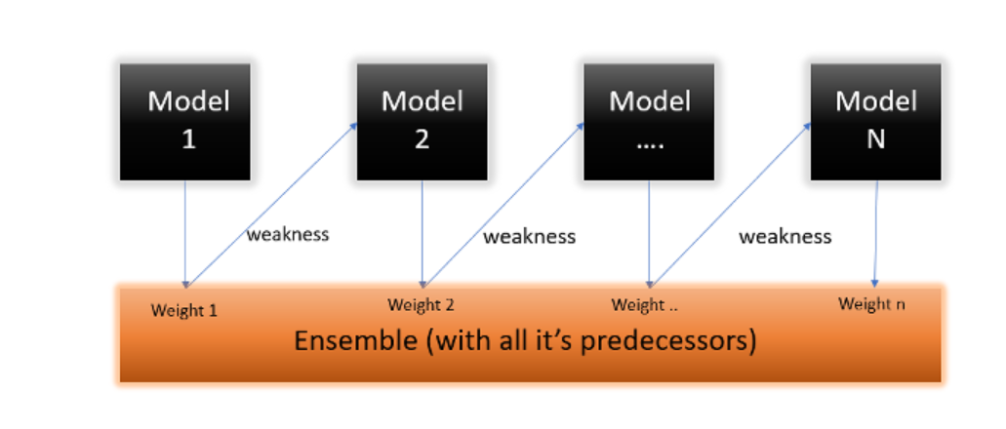
AdaBoost is a sequential boosting algorithm . AdaBoost is simpler to understand and implement. We see the accuracy differs when we build a different model on the same dataset. But what if we use combinations of all these algorithms to make the final prediction? We’ll get more accurate results by taking the average of the results from these models. We can increase the prediction power in this way.

Slide 4
XGBoost Boosting Alogorithm – Extreme Gradient Boosting
Gradient boosting algorithm is one of the most powerful algorithms in the field of machine learning. As we know that the errors in machine learning algorithms are broadly classified into two categories i.e. Bias Error and Variance Error. As gradient boosting is one of the boosting algorithms it is used to minimize bias error of the mode

Slide 5
XGBoost Boosting Alogorithm – Extreme Gradient Boosting
Gradient Boosting Algorithm is generally used when we want to decrease the Bias error. Gradient Boosting Algorithm can be used in regression as well as classification problems. In regression problems, the cost function is MSE whereas, in classification problems, the cost function is Log-Loss.

Slide 6
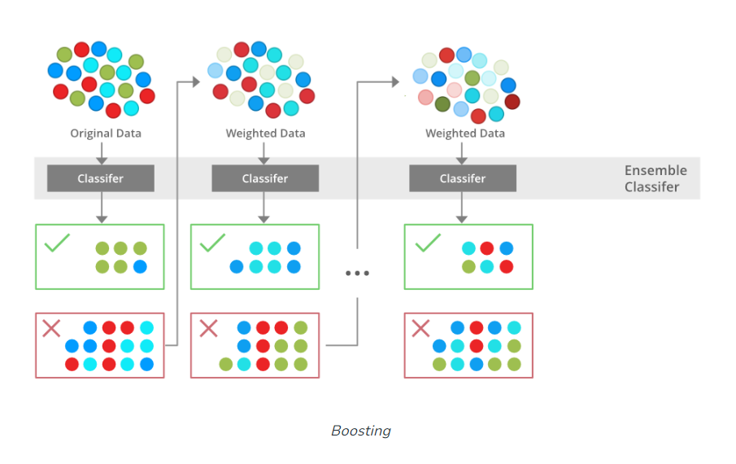
XGBoost Boosting Alogorithm – Extreme Gradient Boosting

Slide 7
XGBoost Boosting Alogorithm – Extreme Gradient Boosting
The XGBoost algorithm works by building a series of regression trees, one at a time. Each regression tree is trained to predict the target variable based on the features of the data. The trees are trained in a sequential manner, with each tree learning from the mistakes of the previous tree.
To train a regression tree, XGBoost uses gradient descent to minimize the loss function. The loss function is a measure of how well the tree is predicting the target variable.
Once the tree is trained, XGBoost uses a regularization technique to prevent overfitting. Overfitting occurs when the tree learns the training data too well and is unable to generalize to new data.
XGBoost then combines the predictions of all the trees to produce a final prediction. This is done using a weighted average, where the weights are determined by the accuracy of each tree.
The XGBoost algorithm is very powerful and can be used for a variety of regression tasks. However, it can be complex to use and there are many parameters that can be tuned to improve the performance of the model.

Slide 8
LGBoost Boosting Alogorithm –
LightGBM is a gradient boosting framework based on decision trees that was developed by Microsoft. It is designed to be fast, distributed, and high-performance, and it is widely used in machine learning competitions and production systems
LightGBM introduces a number of techniques to improve the speed and efficiency of gradient boosting, including
Gradient-based One-Side Sampling (GOSS): This technique reduces the amount of data that needs to be processed by each tree by sampling the data based on the gradient of the loss function.
Exclusive Feature Bundling (EFB): This technique groups features together into bundles, which can be processed more efficiently by the trees.
Histogram-based Tree Splitting: This technique uses a histogram-based approach to split the data at each node of the tree, which is more efficient than the traditional greedy search approach.

Slide 9
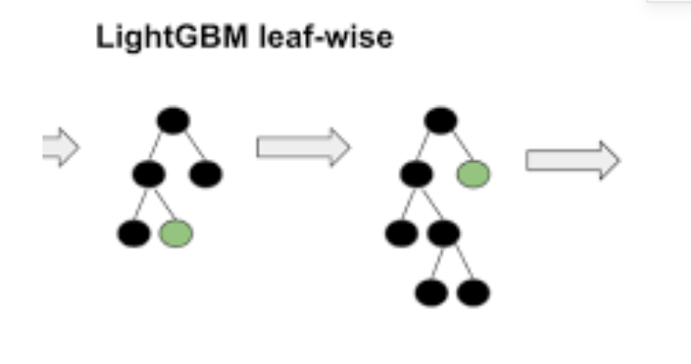
LGBoost Boosting Alogoritm

Slide 10
The LightGBM boosting algorithm works by building a series of decision trees, one at a time. Each decision tree is trained to predict the target variable based on the features of the data. The trees are trained in a sequential manner, with each tree learning from the mistakes of the previous tree. To train a decision tree, LightGBM uses gradient descent to minimize the loss function. The loss function is a measure of how well the tree is predicting the target variable. Once the tree is trained, LightGBM uses a regularization technique to prevent overfitting. Overfitting occurs when the tree learns the training data too well and is unable to generalize to new data. LightGBM then combines the predictions of all the trees to produce a final prediction. This is done using a weighted average, where the weights are determined by the accuracy of each tree.

